Slide 1
Agile Programming
Dirk Riehle, Univ. Erlangen
AMOS B05
Licensed under CC BY 4.0 International

Slide 2
Agenda
Daily scrum
Programming
Programming principles
Programming standards
Refactoring
Technical debt
Refactoring
Test-driven development
Code review
Pair programming
Pre-commit code review
Build processes
Build management
Continuous integration

Slide 3
1. Daily Scrum

Slide 4
Daily Scrum (a.k.a. Daily Standup)
The daily scrum is
A daily status meeting to sync on problems and upcoming work
To be kept as short as possible
Committed parties are mandatory
Only committed parties may speak
Everyone else is optional
Discussions are not allowed, but
Can be had one-on-one after the meeting
Scrum Master will follow-up on problems

Slide 5
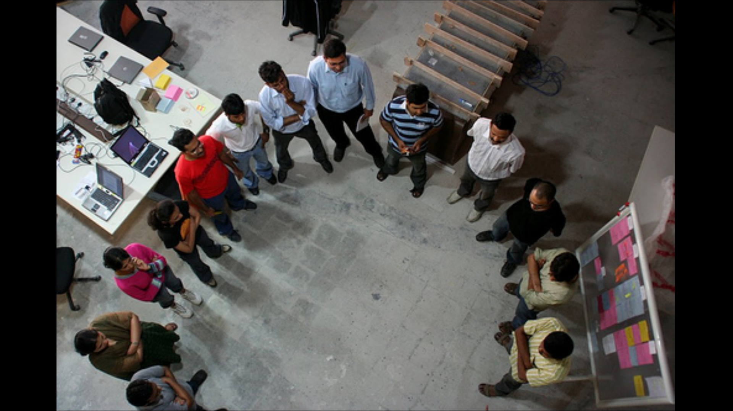
Daily Scrum

Slide 6
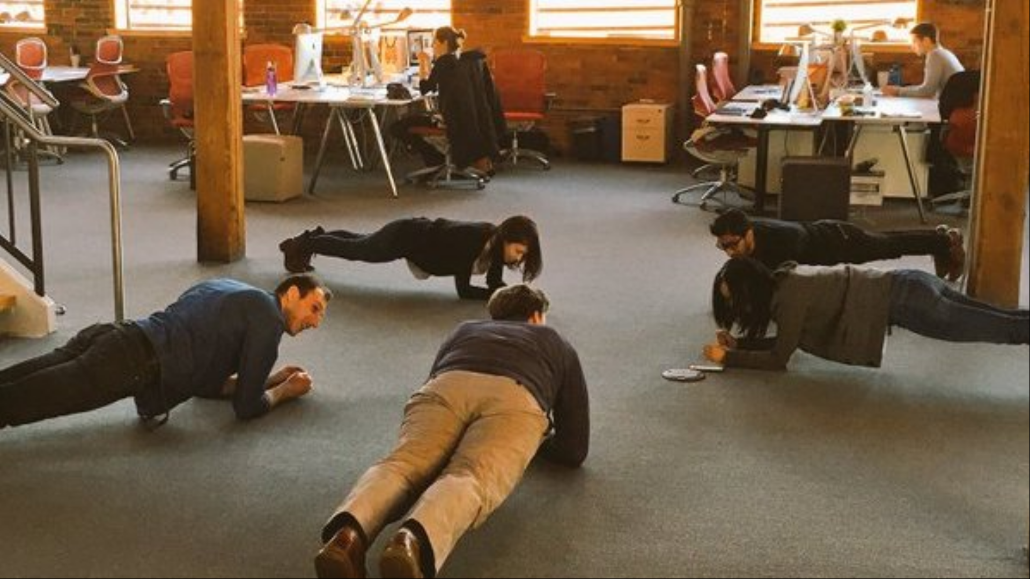
Daily Plank

Slide 7
2. Agile Programming

Slide 8
Programming Principles
KISS (keep it simple, silly)
YAGNI (you ain’t gonna need it)
DRY (don’t repeat yourself)

Slide 9
How to Approach a Programming Problem
Make it run
Make it right
Make it fast

Slide 10
Collective vs. Individual Code Ownership
Collective code ownership
Everyone is equally responsible for the overall code base
Everyone is both allowed to and should be able to fix anything
Instills a feeling of overall responsibility, ensuring high quality
Individual code ownership
Individuals are responsible for their own code
Works best in a distributed setting, e.g. in open source
Agile programming assumes collective code ownership

Slide 11
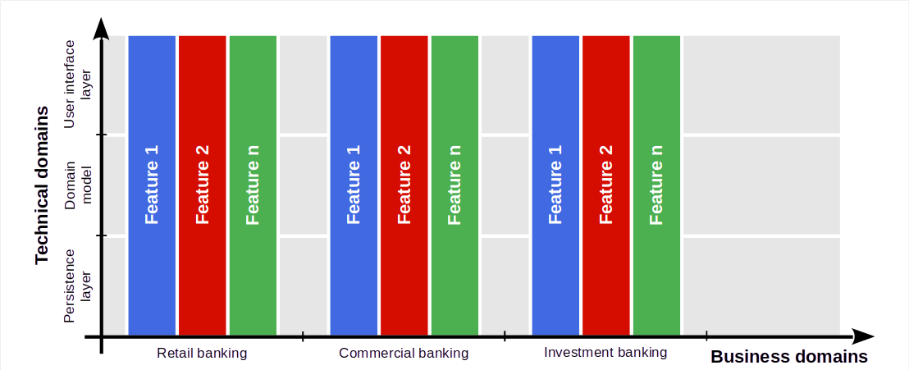
Feature Teams (Dealing With Complexity)

Slide 12
Programming Standards (a.k.a Coding Guidelines)
A programming standard is a
Set of rules and conventions for naming, formatting, and structuring code
A standard makes it easier to read code written by other people
Nine times out of ten, code is read, not written
Programming standards should be mandatory

Slide 13
Professional Language [1]
Query methods | Mutation methods | Helper methods
Get method (getter) | Set method (setter) | Factory method
Boolean query methods | Command method | Cloning method
Comparison method | Initialization method | Assertion method
Conversion method | Finalization method | Logging method
… | … | …
[1] See our course on advanced design and programming (ADAP)

Slide 14
3. Technical Debt

Slide 15

Ward Cunningham on Technical Debt [1]
[1] See https://youtu.be/Jp5japiHAs4

Slide 16
Technical Debt
Technical debt is a
Lack of quality or comprehensiveness of code that
You accept to temporarily speed up development
Until you have to pay back the debt by refactoring
It is a metaphor used to communicate with managers

Slide 17
Managing Technical Debt
Identify the technical debt
By so called “code smells”
Determine the need to act
By correlating occurrences
Know how to pay back
By refactoring your code

Slide 18
Code Smells [1]
Code smells are
Identifiable structures in code that
Violate established design principles and
Reduce overall code quality
Code smells are not bugs (the code works, it just … smells)
[1] Fowler, M. (1999). Refactoring. Addison-Wesley Professional.

Slide 19
Example Code Smells
Duplicate code
Long method
Large class
…

Slide 20
The “Three Strikes” Rule
First time: Just do it
Second time: Wince at duplication
Third time: Refactor

Slide 21
Refactoring
A refactoring is a
Behavior-preserving transformation of code (with the goal of improving it)

Slide 22
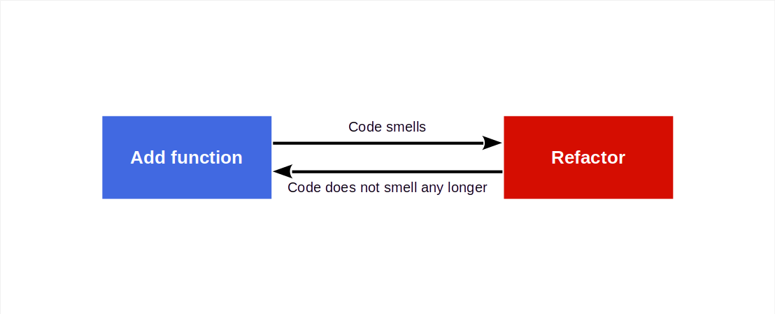
Refactoring Process (“Two Hats”)

Slide 23
Example Refactorings
Extract method
Pull up field
Form template method
Decompose conditional
Extract class
Extract subclass
Extract interface
…

Slide 24
Example Smell Removal by Refactoring
Remove Duplicated Code by Extract Method or Pull Up Field or …
Remove Long Method by Extract Method or Decompose Conditional or …
Remove Large Class by Extract Class or Extract Subclass or …

Slide 25
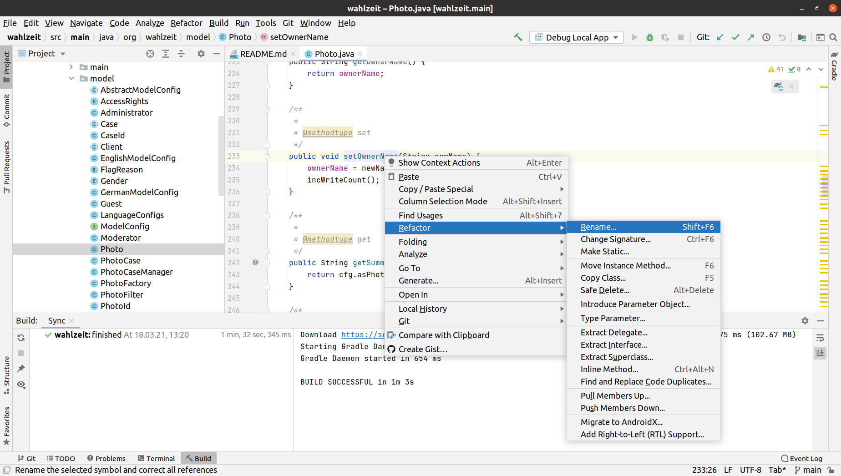
IDEs Readily Support (Some) Refactorings

Slide 26
4. Test-Driven Development

Slide 27
Test Terminology
Testing is a process for assessing correct operation according to a specification
A test is the instructions to perform a specific assessment
Component tests (unit tests) test a particular component in isolation
Acceptance tests (functional tests) test a cross-cutting function
Integration tests test the interaction of several components
Tests can be automated or manually performed

Slide 28
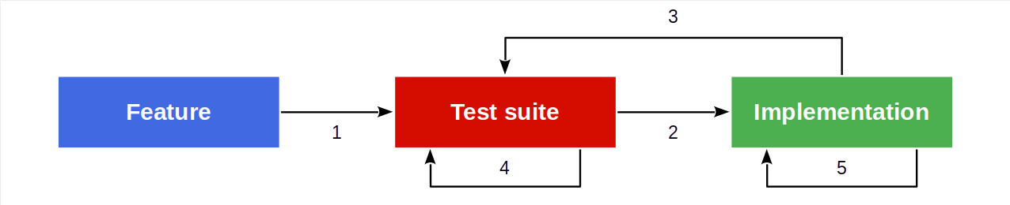
Test-First Programming
Test-first programming is the
Practice of first writing a test and then making the system pass the test

Slide 29
Rules of Test-first Programming
Only write new code if a test fails, then eliminate waste
Red, green, refactor

Slide 30
Test-Driven Development
Test-driven development is a
Minimal development process based on test-first programming

Slide 31
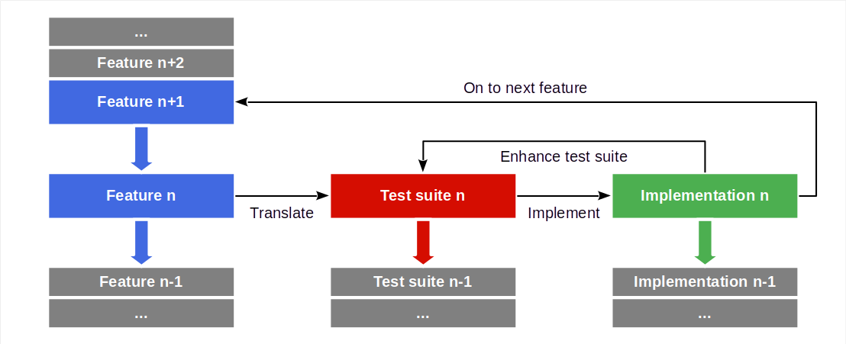
Test-Driven Development Process

Slide 32
5. Code Review

Slide 33
Code Review
Code review is the practice of
Having someone else assess your code for feedback and approval
More formally, a code review is
The systematic examination [...] of computer source code
Common forms of code review are
Pair programming
Walkthroughts
Inspections

Slide 34
When to Perform Code Reviews
As code is written (→ Pair Programming)
Before a commit (→ Pre-commit Code Review)
Before a release
At some other time

Slide 35
Pair Programming
Pair programming is the practice of
Two people in front of the same display, with
One person implementing, i.e. writing code (acting in the moment), and
One person reviewing, i.e. watching, thinking, commenting, steering
These are the programmer and the reviewer, also
Driver and co-driver
Pilot and navigator

Slide 36
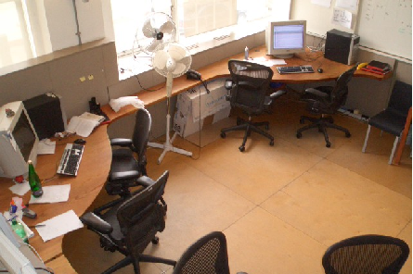
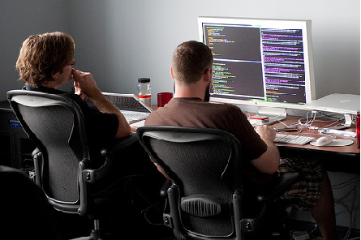
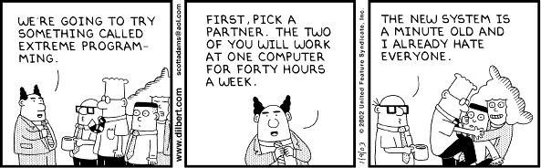
Advice on Pair Programming
Find comfortable partner
Switch roles regularly
Communicate regularly
Don’t force it for small stuff
Don’t overheat, take breaks
Switch partners at times

Slide 37
Pre-Commit Code Review
Pre-commit code review is the practice of
Having a peer review code for feedback and approval before it gets committed
The benefits of pre-commit code review
Strengthens feeling of collective responsibility
Improves knowledge sharing and teamwork
Catches bugs and problems at the right time
Leads to more disciplined developers
Raises overall quality cost-efficiently
Made easy today through merge requests

Slide 38
6. Build Processes

Slide 39
Build Process
A build process is the process of
Creating an installable software from its source artifacts
Quality criteria of a build process are
Fully automated
Reentrant and deterministic
With a defined context independent environment
All build assets need to be managed properly

Slide 40
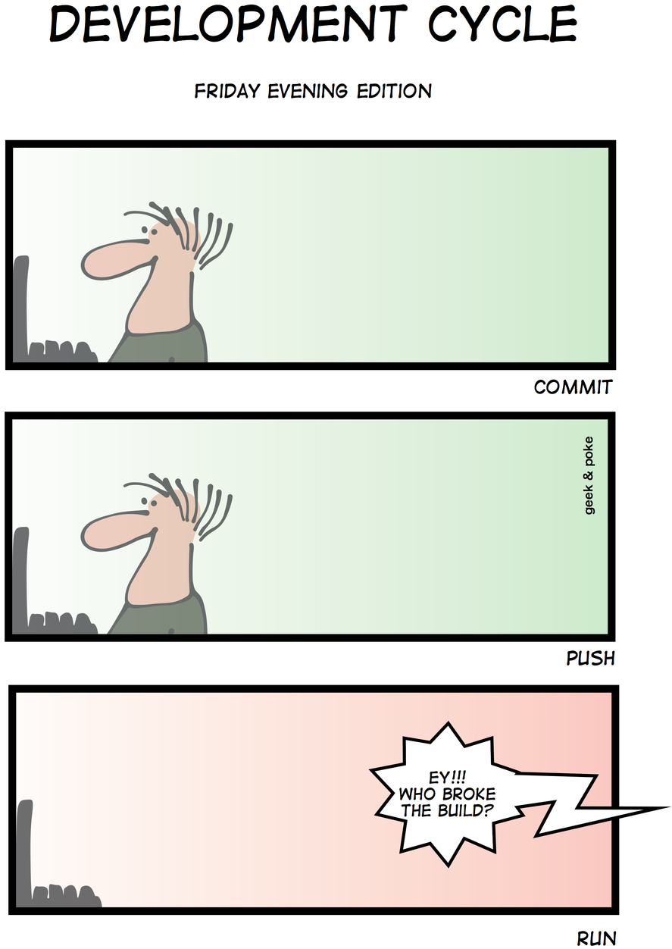
Developer Responsibilities
Don’t break the build
Only commit code that compiles
Only commit code that passes all tests
Only work in a standardized work environment

Slide 41
Continuous Integration
Continuous integration is the practice of
Automatically building and testing the software upon defined triggers
Usually with every commit of a developer
Sometimes only once per day (nightly builds)
Continuous integration may have different scopes
Depending on the size of the software under development
The goal is to always know whether the software is in good working order

Slide 42
Continuous Deployment
Continuous deployment is the practice of not only building and testing but of
Deploying the software into production
Users are the final deciders of
Whether the software does what is expect of it
Continuous deployment requires monitoring the performance of the software
Beyond system tests, you need to watch key metrics of performance

Slide 43
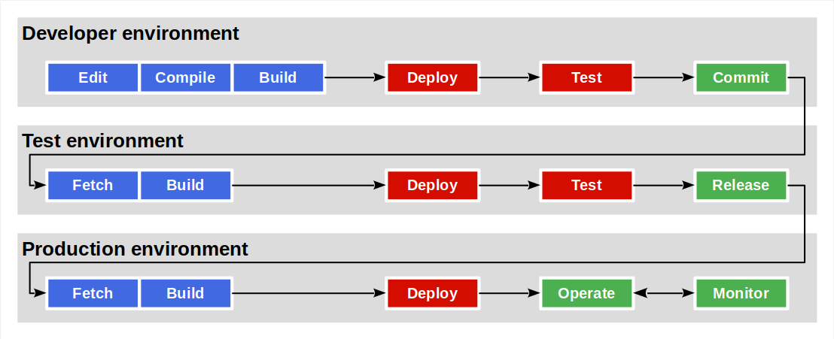
Separation of Environments

Slide 44
One-time Deliverable: Build Process Video
Please create a recorded from-scratch demonstration of your full build process
If you run a continuous integration process, great! But not required

Slide 45
Summary
Daily scrum
Programming
Refactoring
Test-driven development
Code review
Build processes

Slide 46
Thank you! Any questions?
dirk.riehle@fau.de – https://oss.cs.fau.de
dirk@riehle.org – https://dirkriehle.com – @dirkriehle

Slide 47
Legal Notices
License
Licensed under the CC BY 4.0 International license
Copyright
© Copyright 2023 Dirk Riehle, some rights reserved

